Slide 1
Lecture 3
Relationships in OO design

Slide 2
What is Object-Orientation?
It is a technique in which we visualize our programming problems in the form of objects and their interactions as happens in real life.

Slide 3
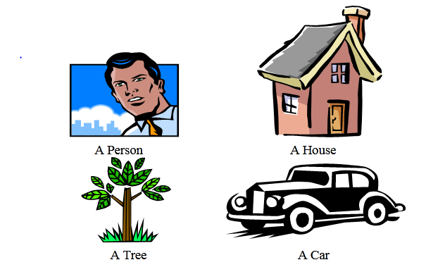
How these objects interact with each other?

Slide 4
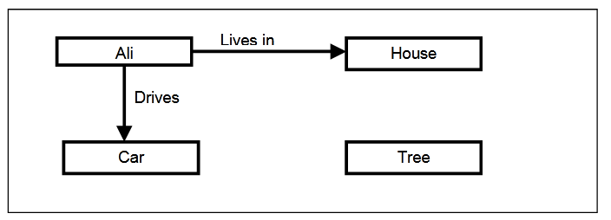
Model

Slide 5
Another Example
Take another example of a School; the objects in a school are student, teacher, books, pen ,school bag, classroom, parents, playground.

Slide 6
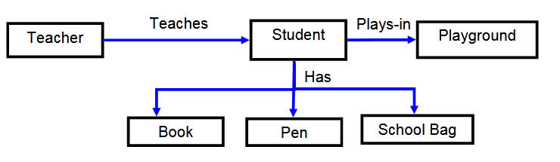
School Model

Slide 7
Different types of Relationships
Association
Aggregation
Composition

Slide 8
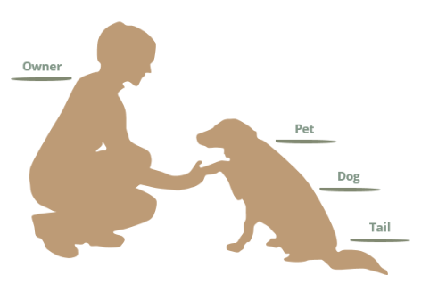

Slide 9
We see the following relationships:
owners feed pets, pets please owners (association)
a tail is a part of both dogs and cats (aggregation / composition)
a Dog is a kind of pet (inheritance / generalization)

Slide 10
Association
Association is a semantically weak relationship (a semantic dependency) between otherwise unrelated objects. An association is a “using” relationship between two or more objects in which the objects have their own lifetime and there is no owner.

Slide 11
As an example, imagine the relationship between a doctor and a patient. A doctor can be associated with multiple patients. At the same time, one patient can visit multiple doctors for treatment or consultation.
Each of these objects has its own life cycle and there is no “owner” or parent. The objects that are part of the association relationship can be created and destroyed independently.

Slide 12
Association Between Same Class
Association may exist between objects of the same class. For example, an Employee may have a supervisor.

Slide 13
Aggregation
An aggregation relationship can be described in simple words as "an object of one class can own or access the objects of another class."
In an aggregation relationship, the dependent object remains in the scope of a relationship even when the source object is destroyed.

Slide 14
Composition
Composite is a subtype of aggregation relation with characteristics as:
It is a whole/part relationship.
If a composite is deleted, all other parts associated with it are deleted.

Slide 15
